Slide 1
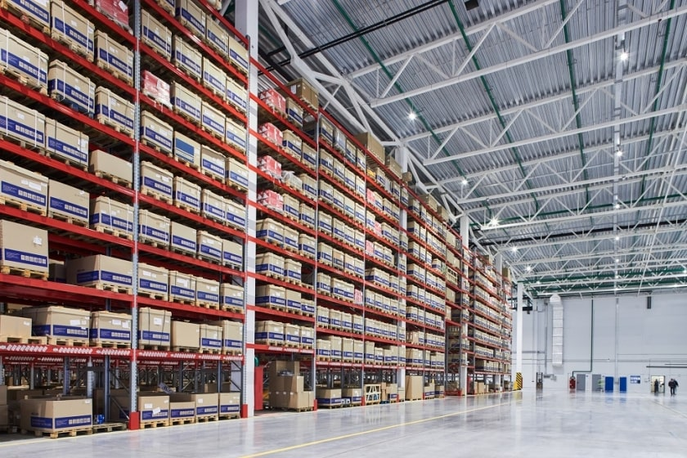

AtliQ Hardware Sales & Finance Analytics
Presentation by:
Sagar More
1

Slide 2


Contents
o1.
Introduction
o2.
Problem Statement
o3.
Data Sources & Tools
o4.
Data Model
o5.
DAX Measures
o6.
Reports Overview
o7.
Sales Report
o8.
Finance Report
o9.
Insights
2

Slide 3
Introduction
1.
Domain: FMCG
Business Overview:
AtliQ Hardware is company that sells computer hardware and peripherals like PC, mouse, printer etc. to clients across the world.
They have a major B2B business model wherein they sell to stores like Croma, Best Buy, Staples, Flipkart etc. who then sell it to the end users (consumers). These stores are their main customers.
They sell through 3 channels: Retailer, Direct and Distributor.
AtliQ Hardware’s Customers are of two types. Both these Platforms are called Retailer channels. 1. Brick & Mortar Customer: Actual physical stores e.g. Croma, Best Buy 2. E-commerce Customer: Online websites E.g. Amazon, Flipkart
AtliQ Hardware also has a minor B2C business model wherein they own stores: AtliQ E-store and AtliQ Exclusive. These are called Direct channels.
They also have Distributors in some countries with restricted trade. E.g. Neptune
3

Slide 4
Problem Statement
2.
AtliQ Hardware is facing significant losses in recent years.
They have been relying on hand written reports for business decisions.
They are in a dire need of insights for informed data driven decision making.
Business Requirement: AtliQ’s business users have tasked the Data Analyst team with preparing an Excel Analysis Report focused on Sales and Financial performance by analyzing data from multiple files with over 1.5 million records to help them derive data insights towards boosting business growth.
4

Slide 5
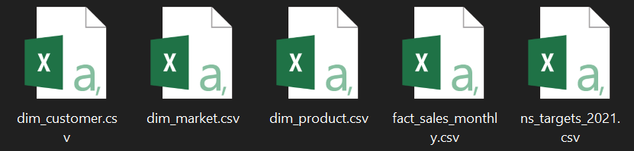
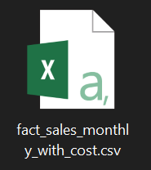
Data Sources & Tools
3.
Data Sources: Sales & Finance
Analysis Tool & Skills:
Microsoft Excel:
Power Query
Pivot Table
Power Pivot
Data Modelling
DAX Measures & Columns
Conditional Formatting
5

Slide 6
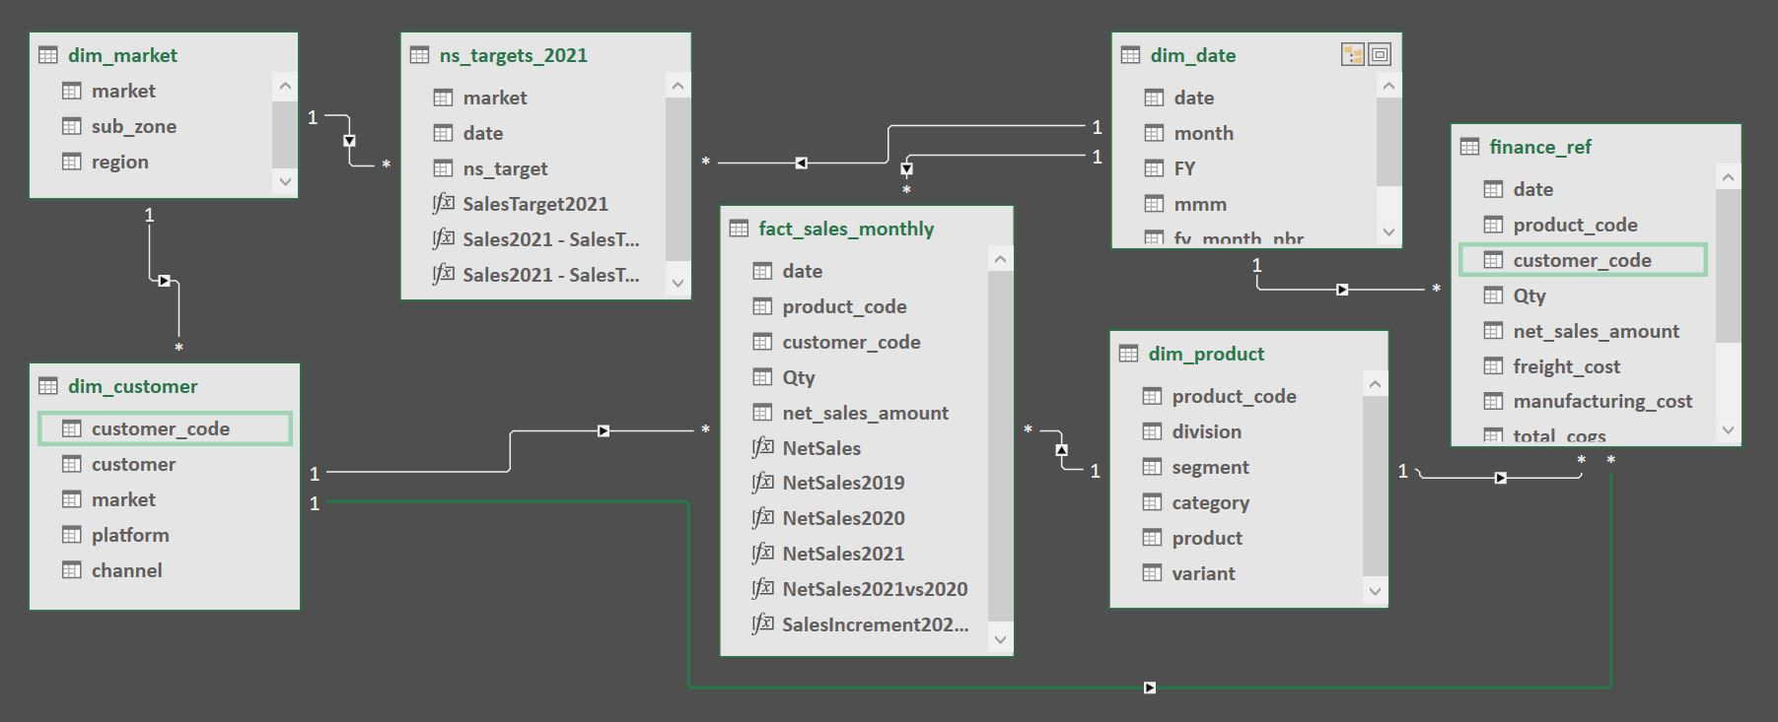
Data Model
4.
Entity Relationship Diagram:
6

Slide 7
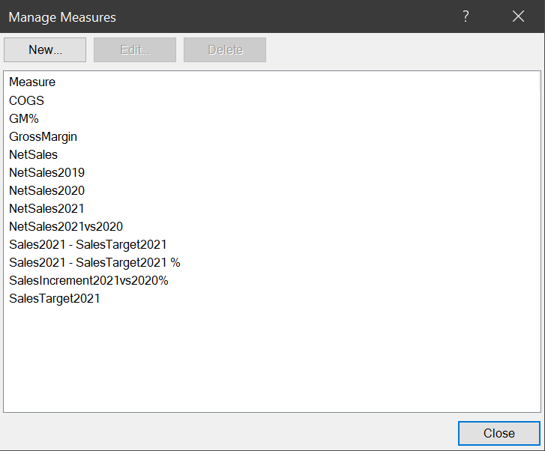
DAX Measures
5.
Measure Formulas:
COGS =SUM(finance_ref[total_cogs])
GM% =DIVIDE([GrossMargin],[NetSales],0)
GrossMargin =[NetSales]-[COGS]
NetSales =SUM(fact_sales_monthly[net_sales_amount])
NetSales2019 =CALCULATE([NetSales], dim_date[FY]="2019")
NetSales2020 =CALCULATE([NetSales], dim_date[FY]="2020")
NetSales2021 =CALCULATE([NetSales], dim_date[FY]="2021")
NetSales2021vs2020 =DIVIDE([NetSales2021], [NetSales2020],0)
Sales2021 - SalesTarget2021 =[NetSales2021] - [SalesTarget2021]
Sales2021 - SalesTarget2021 % =DIVIDE([Sales2021 - SalesTarget2021], [SalesTarget2021], 0)
SalesIncrement2021vs2020% =DIVIDE([NetSales2021]-[NetSales2020],[NetSales2020],0)
SalesTarget2021 =SUM(ns_targets_2021[ns_target])
7

Slide 8

Reports Overview
6.
Sales Reports:
Customer Performance Report
Market Performance vs Target Report
Top 10 Products
Division level Report
Top & Bottom 5 Products Report
New 2021 Products Report
Top 5 Country 2021 Report
Finance Reports:
P&L - Financial Years
P&L - Financial Months
P&L - Markets
GM% - Financial Quarters
8

Slide 9
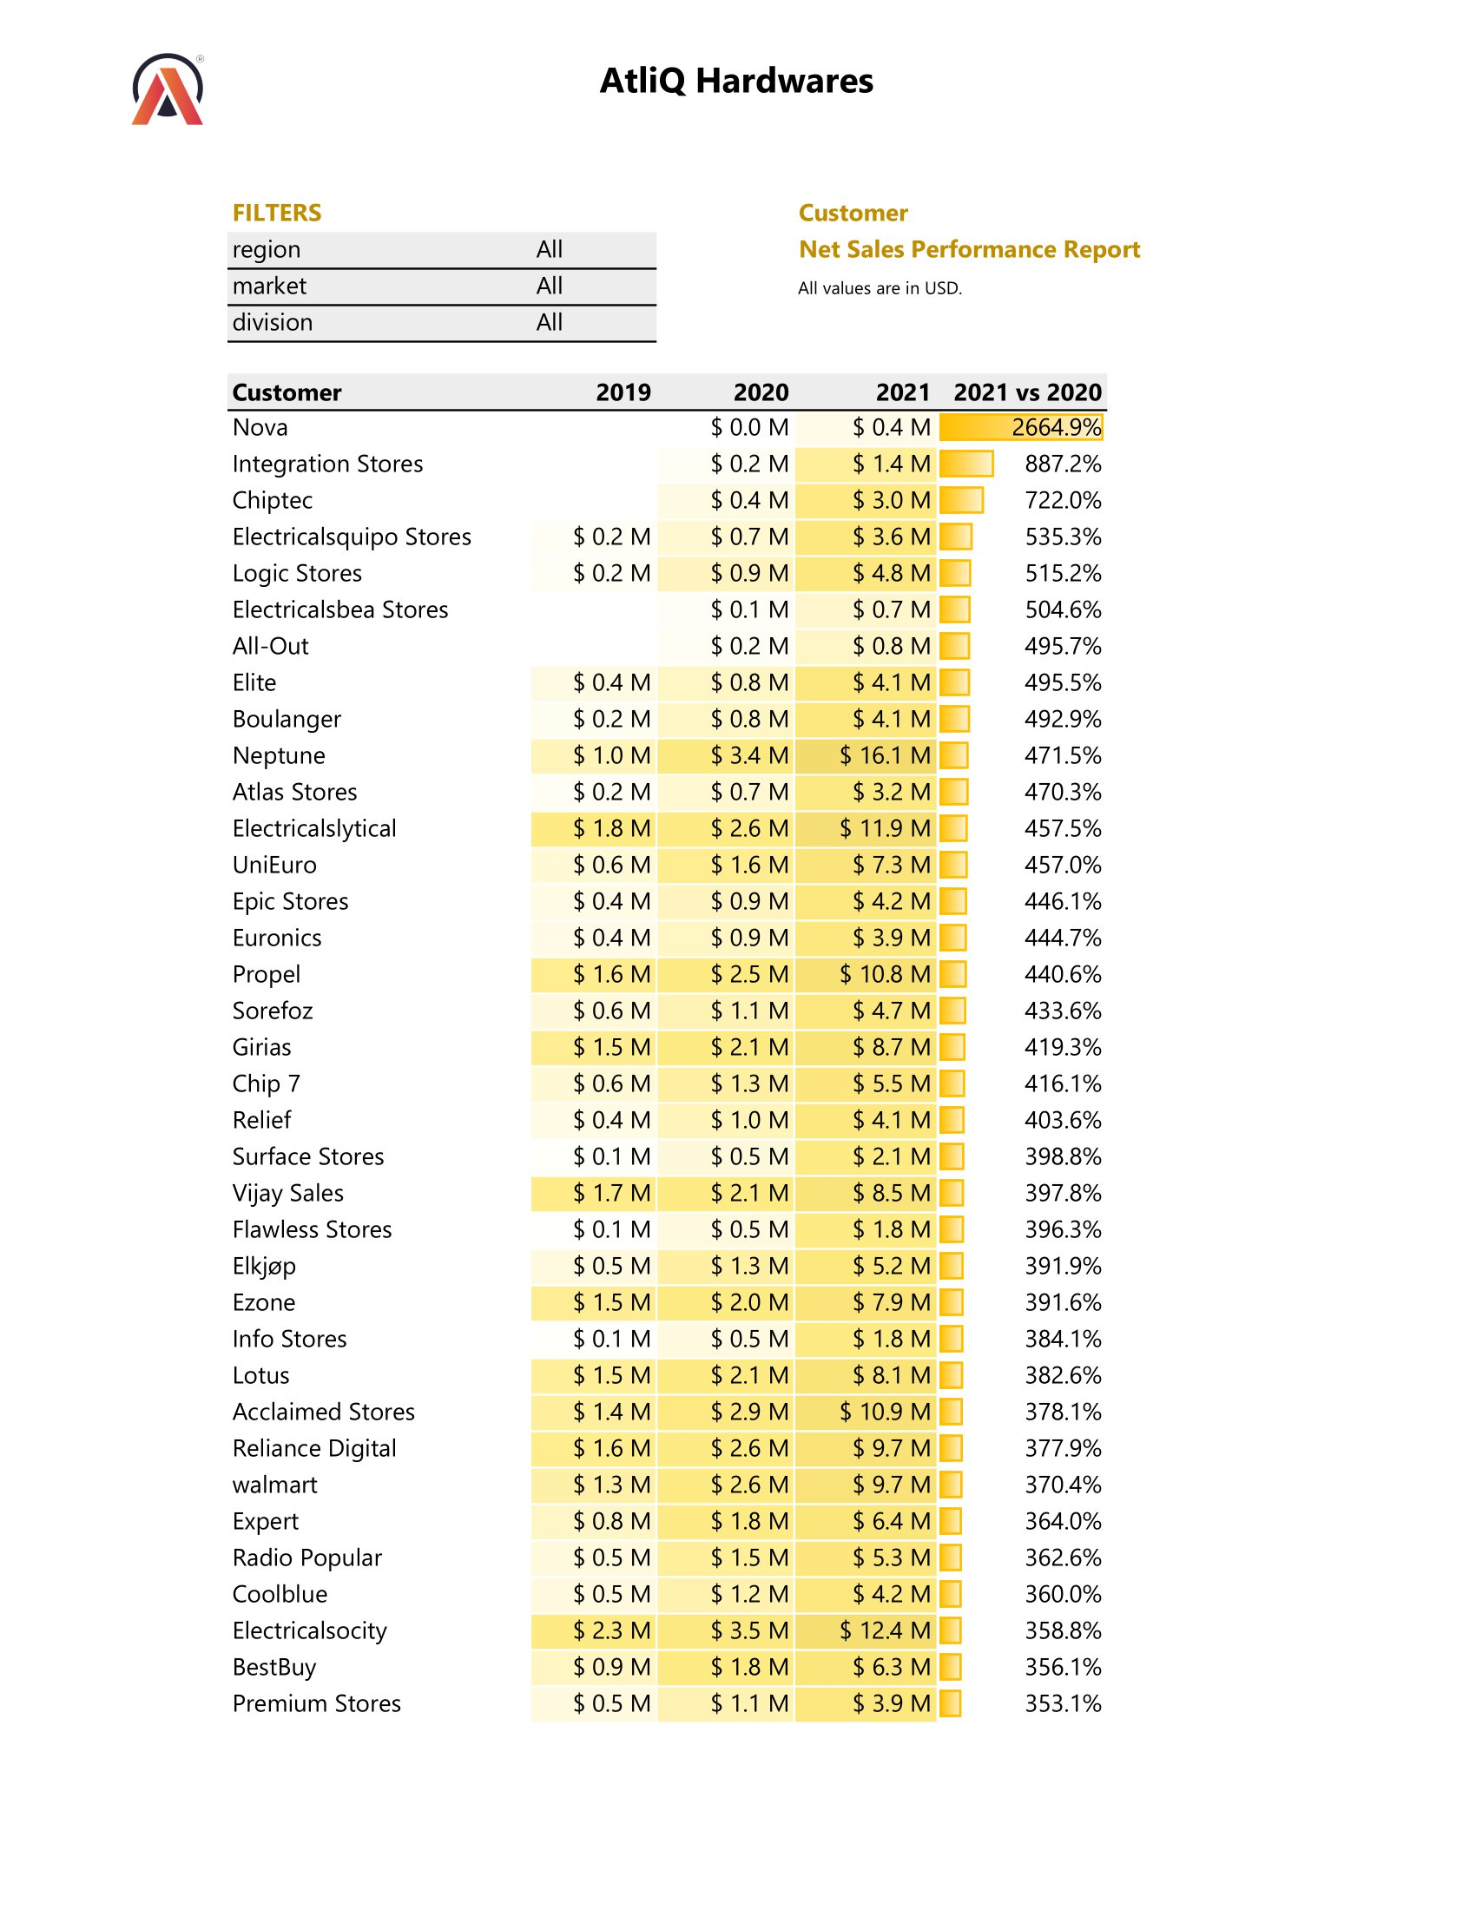
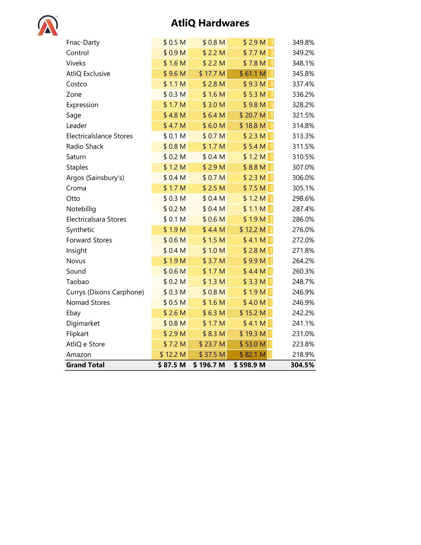
Sales: Customer Performance Report
7.1
9

Slide 10
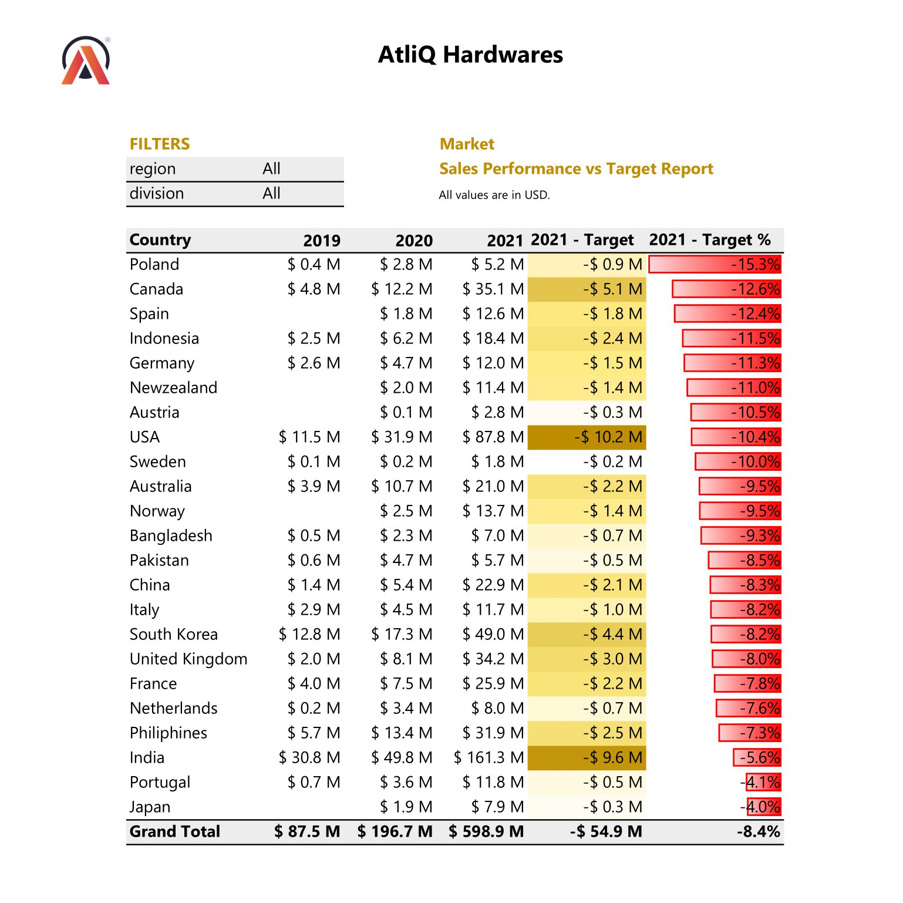
Sales: Market Performance vs Target Report
7.2
10

Slide 11
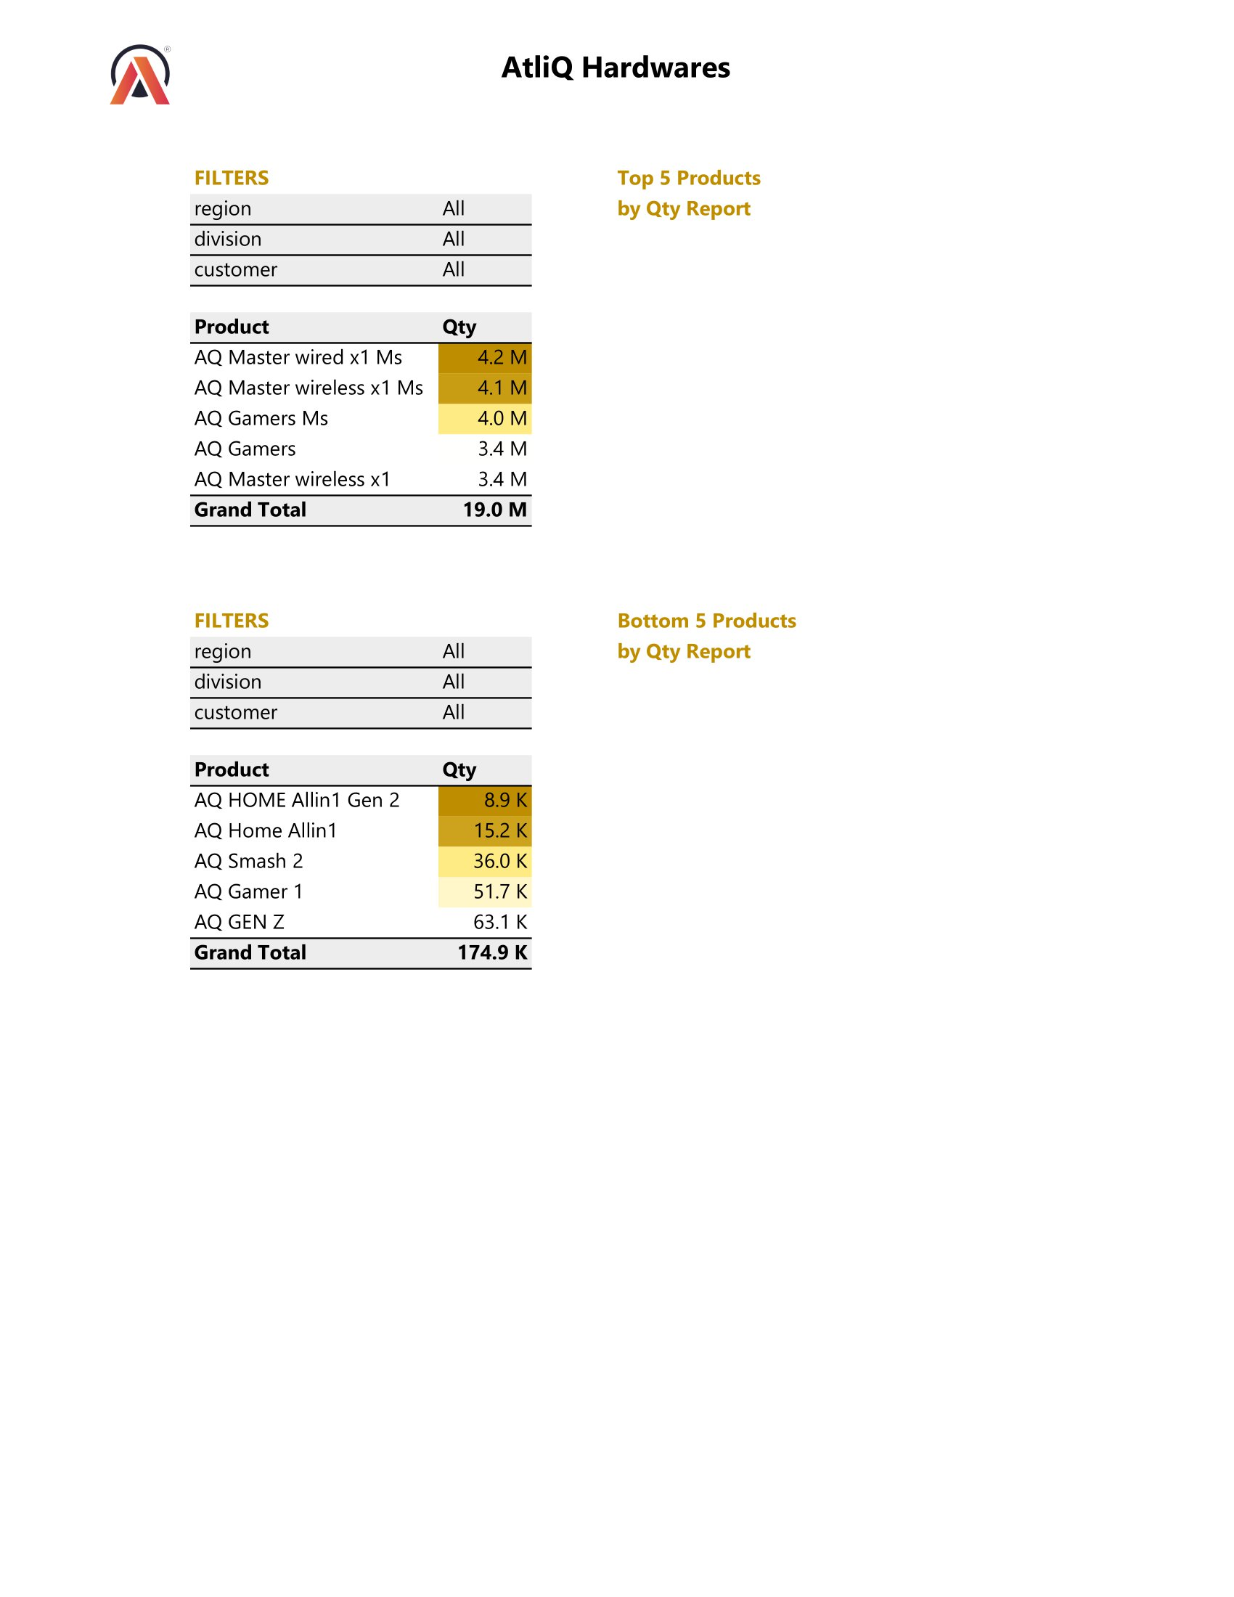
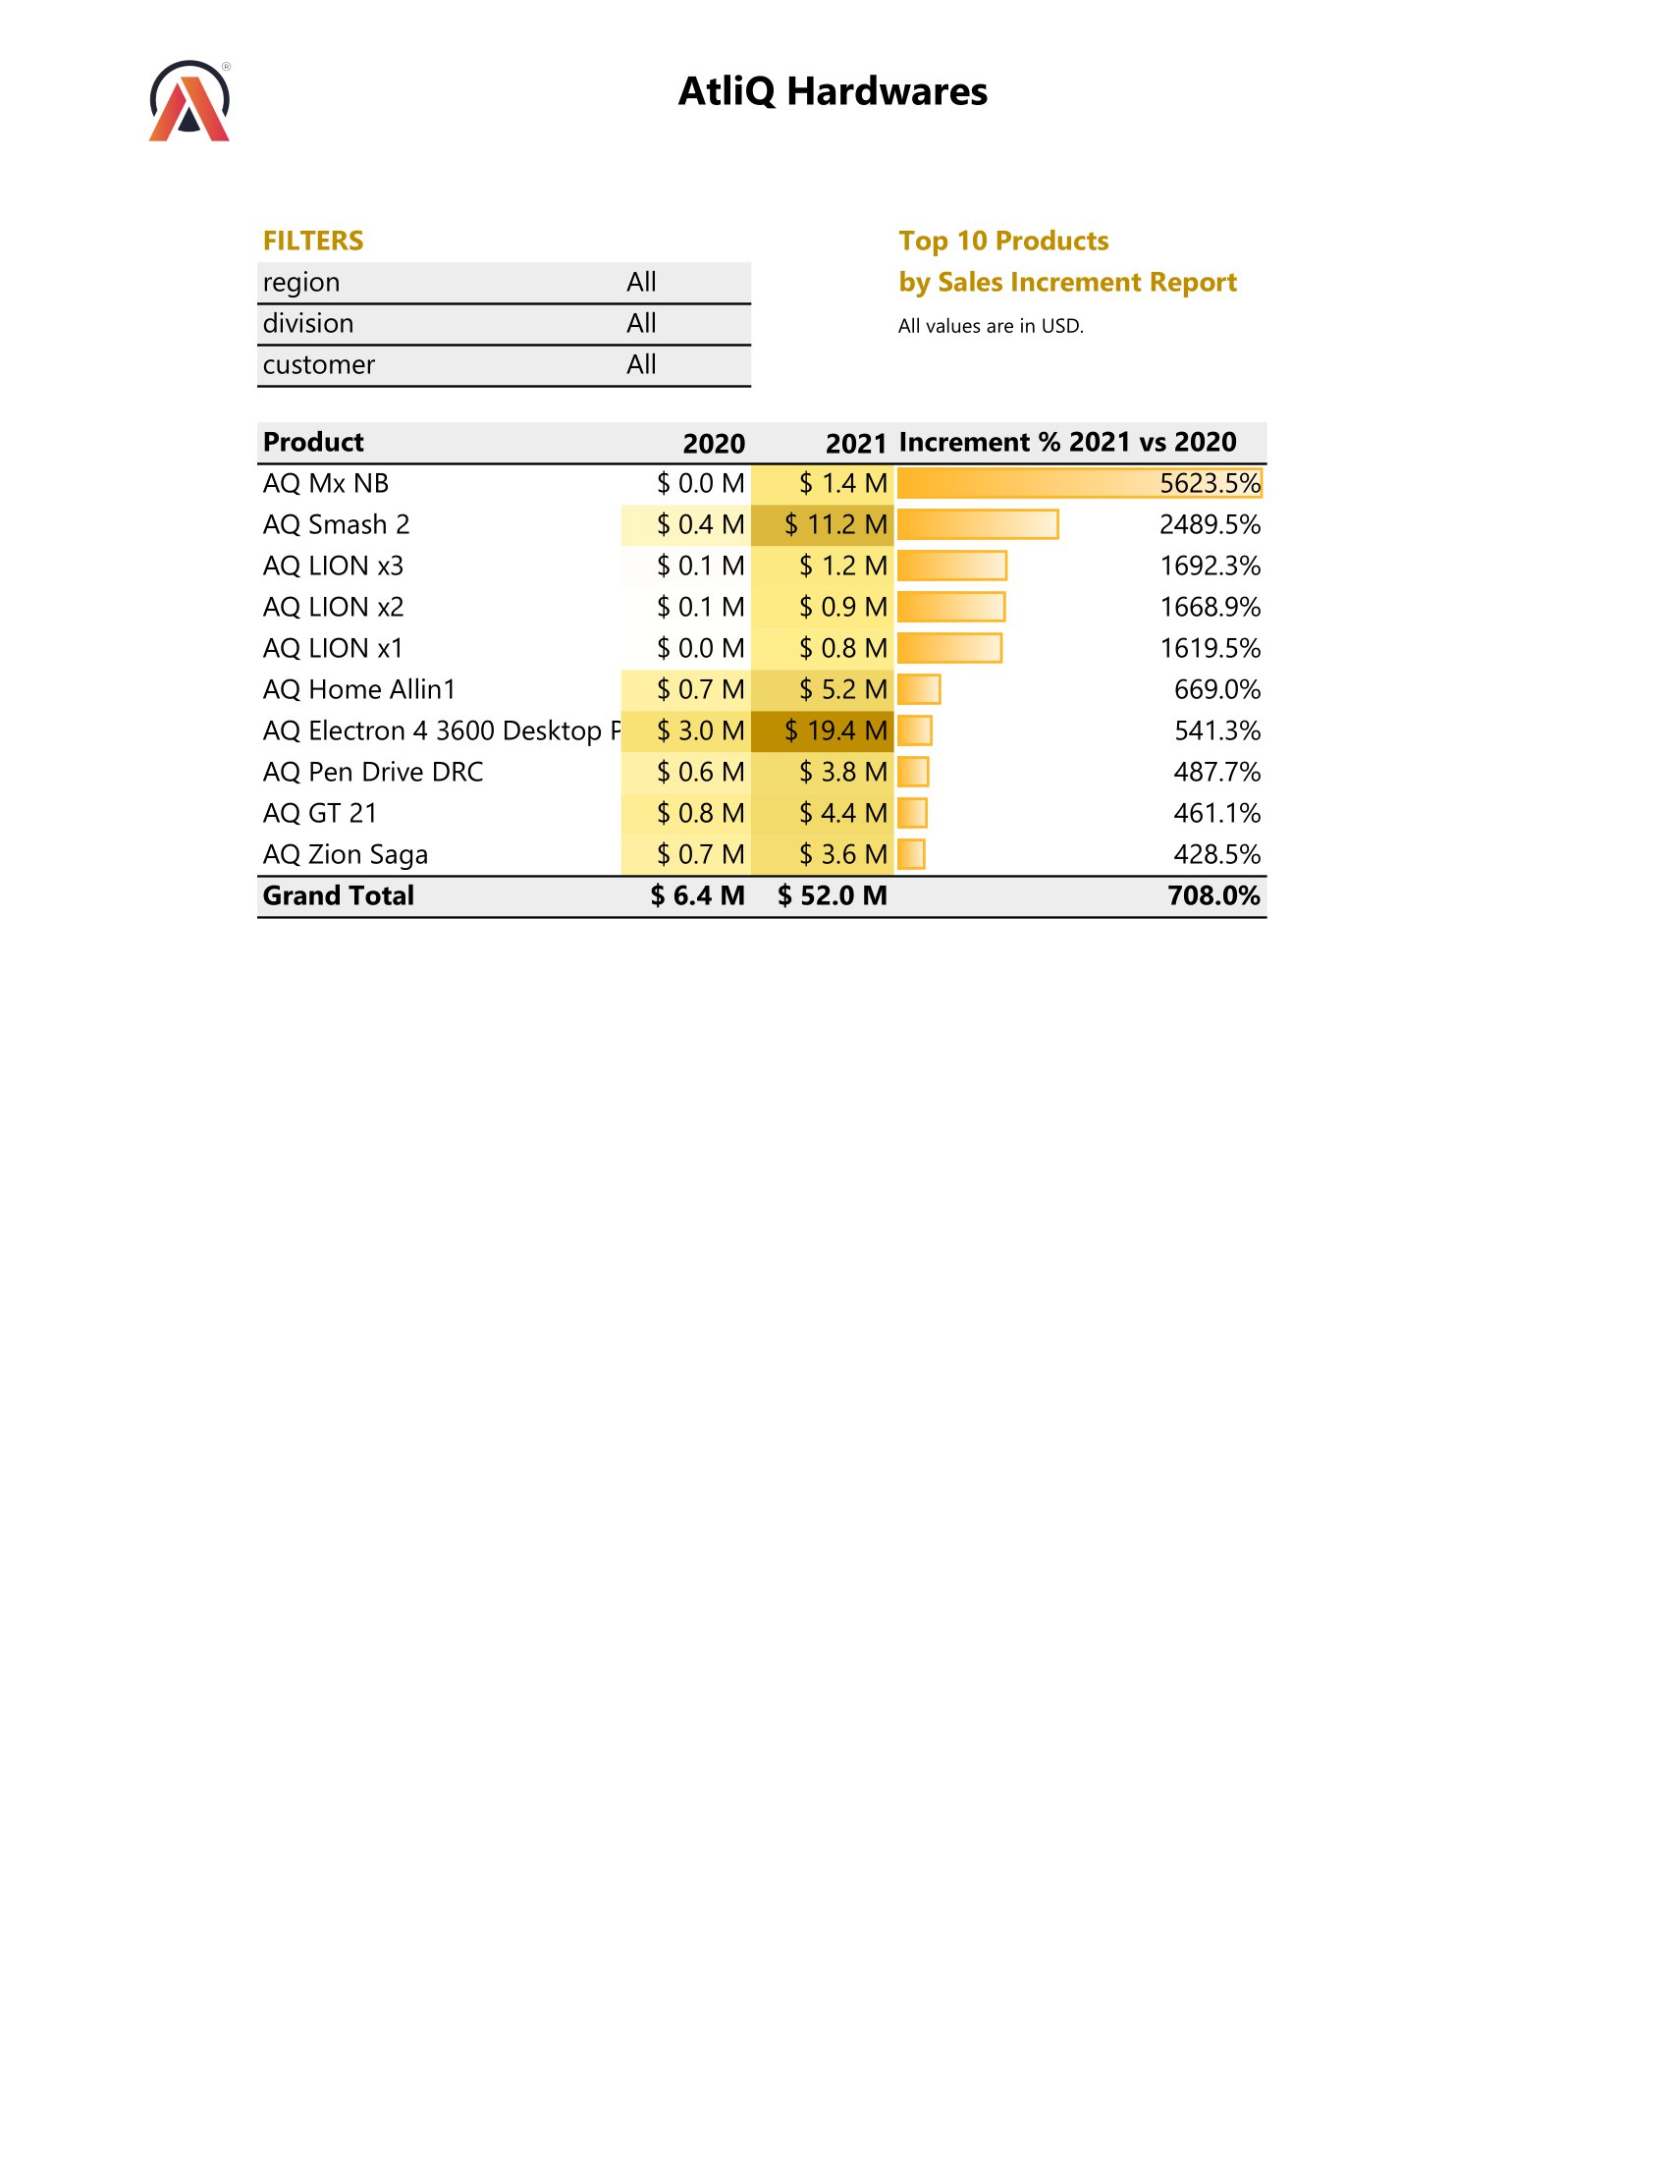
Sales: Products by Sales & Qty Reports
7.3
11

Slide 12
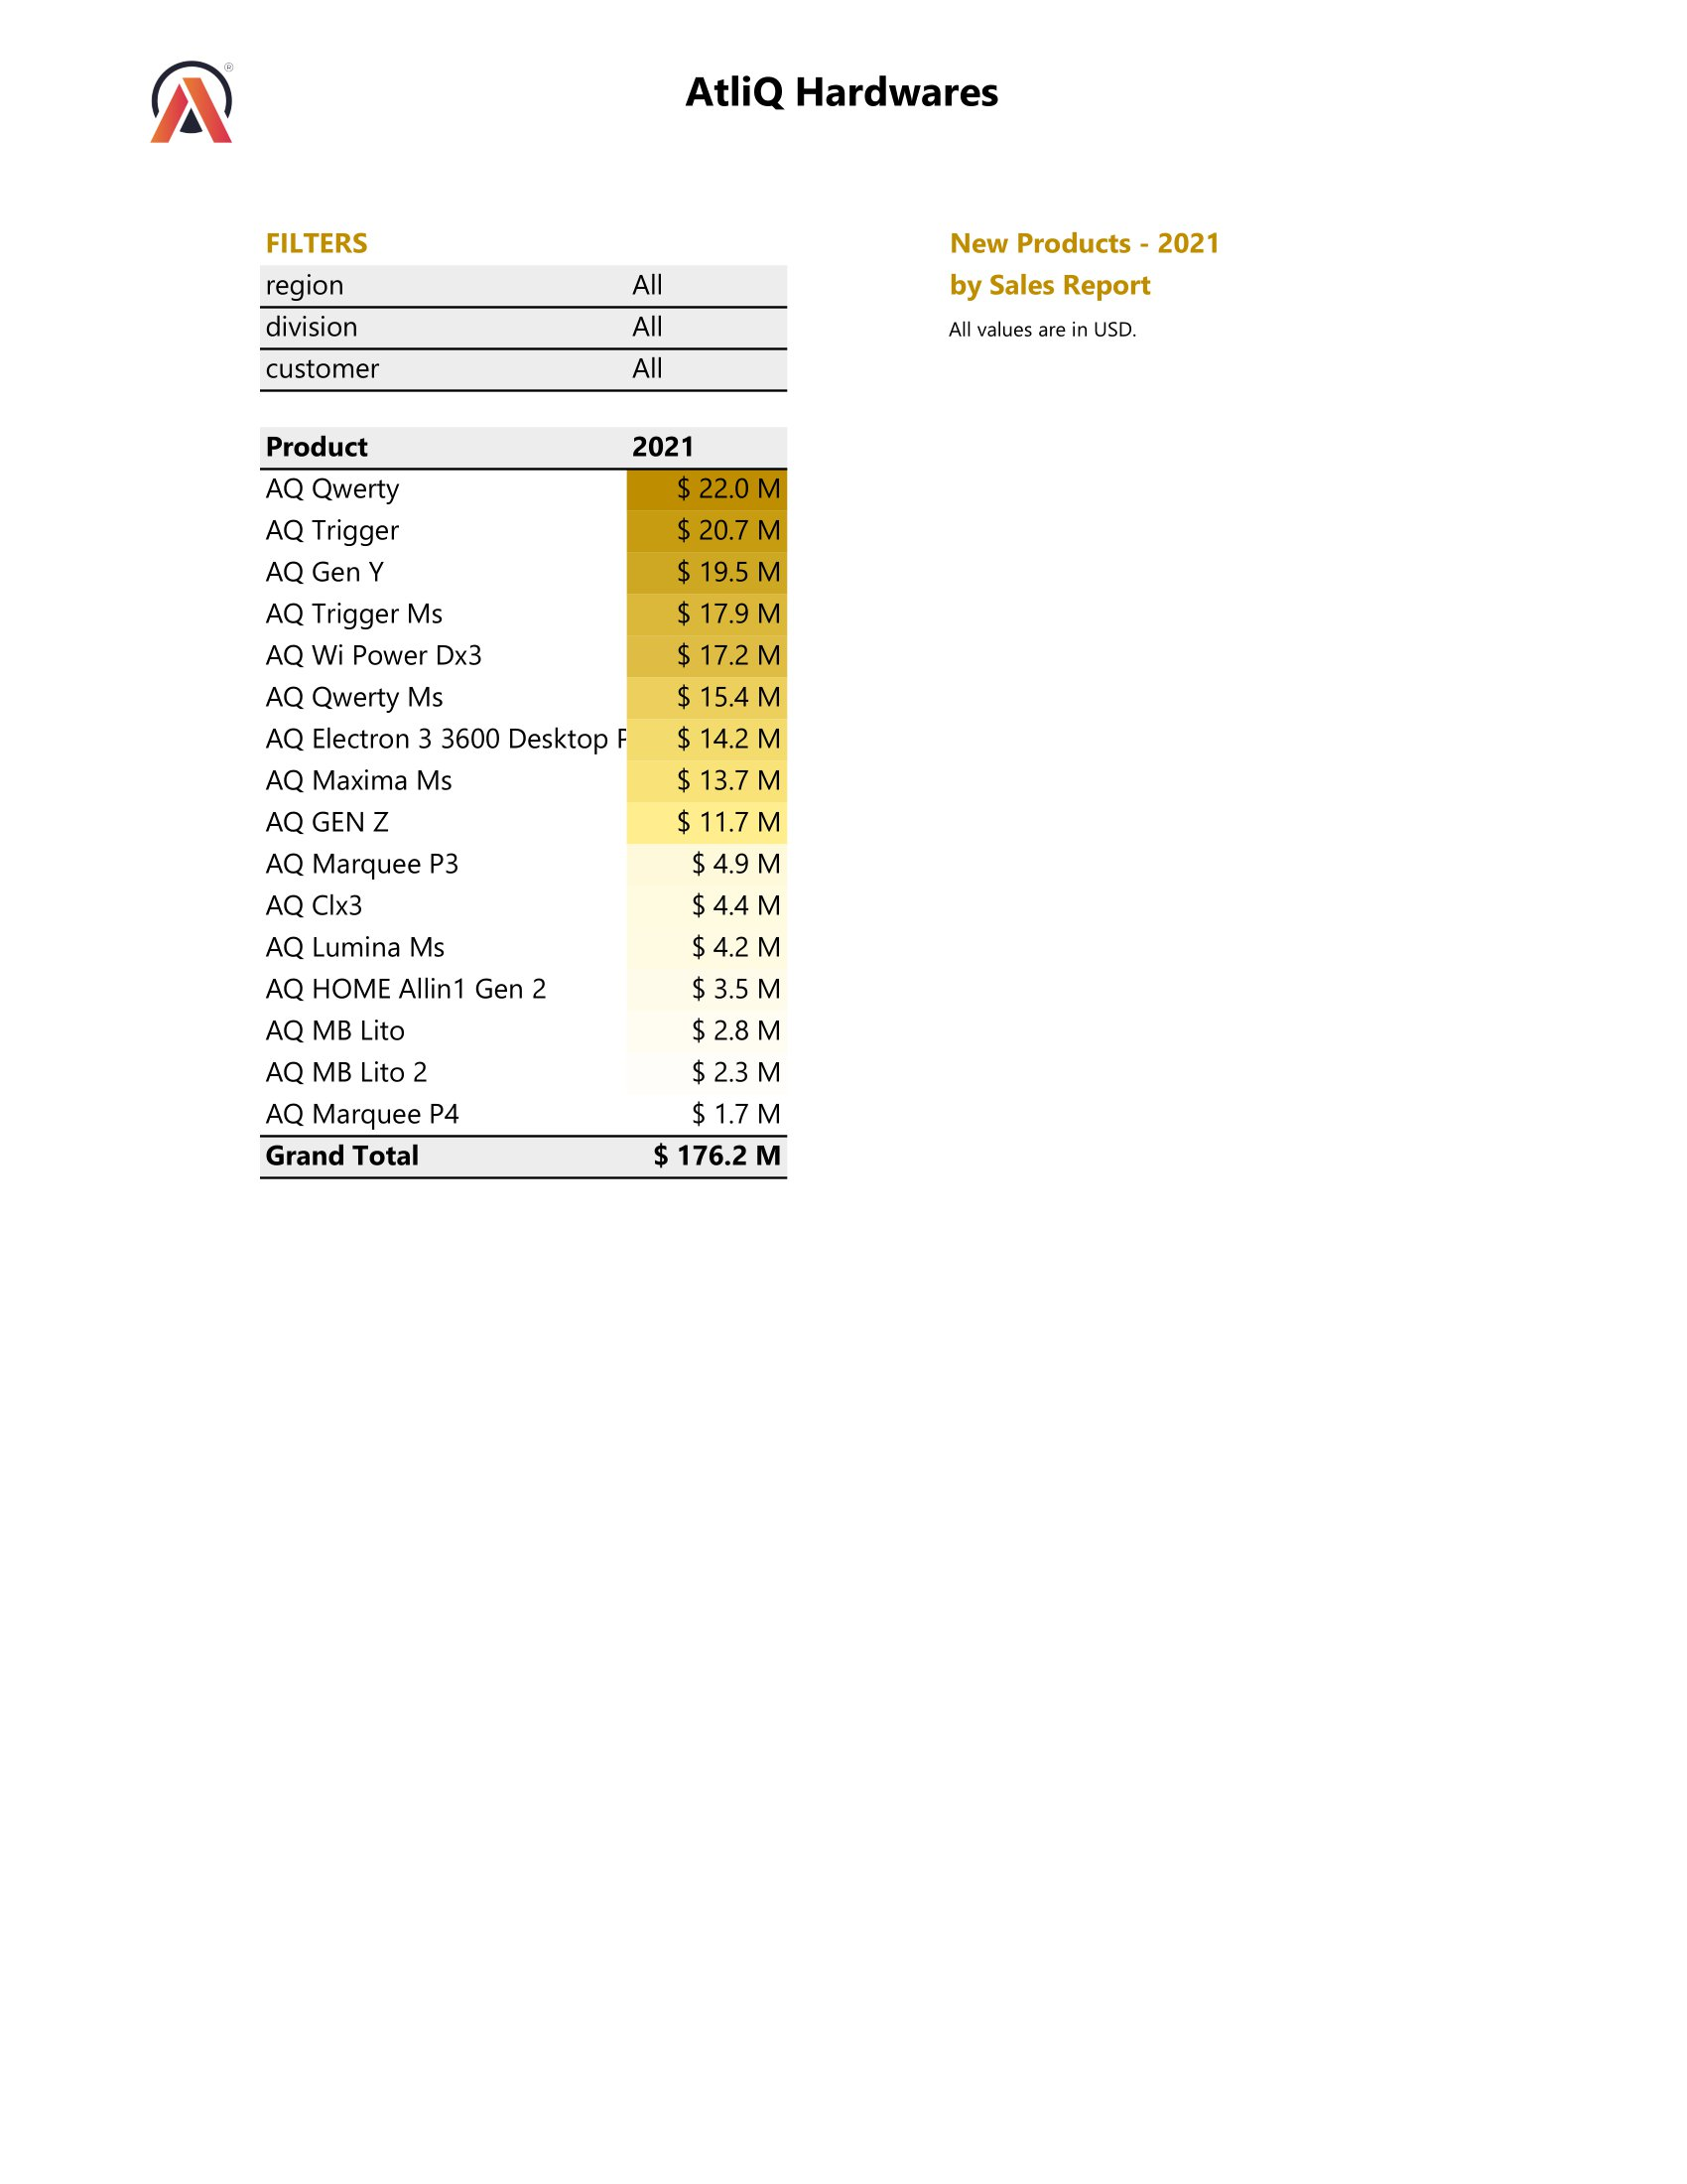
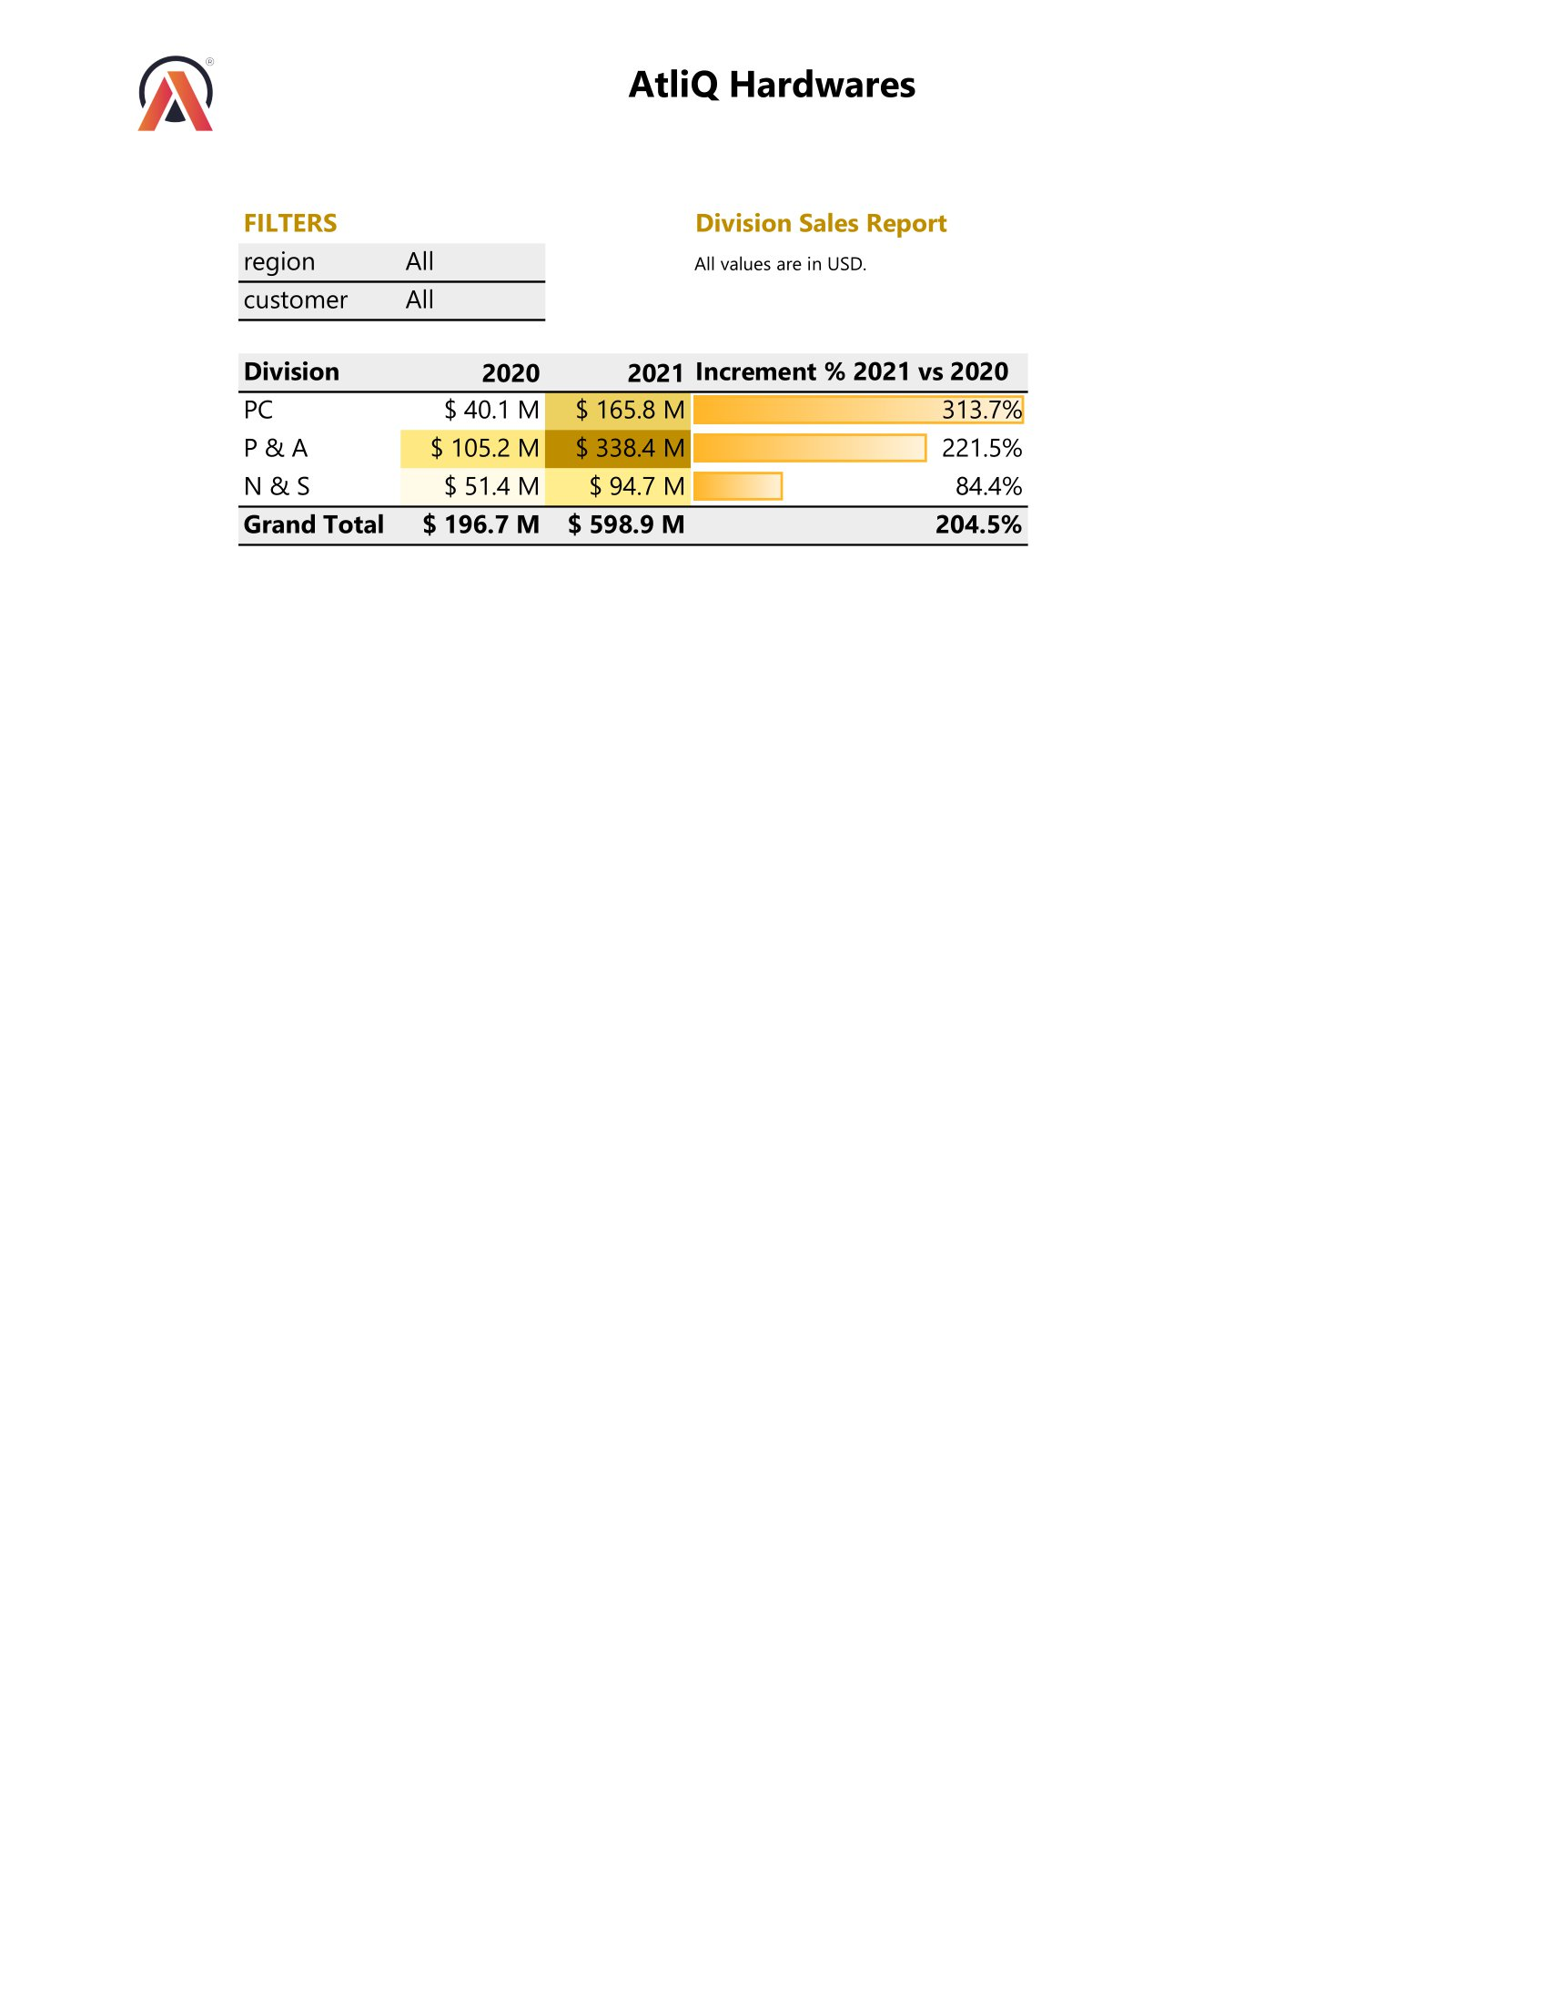
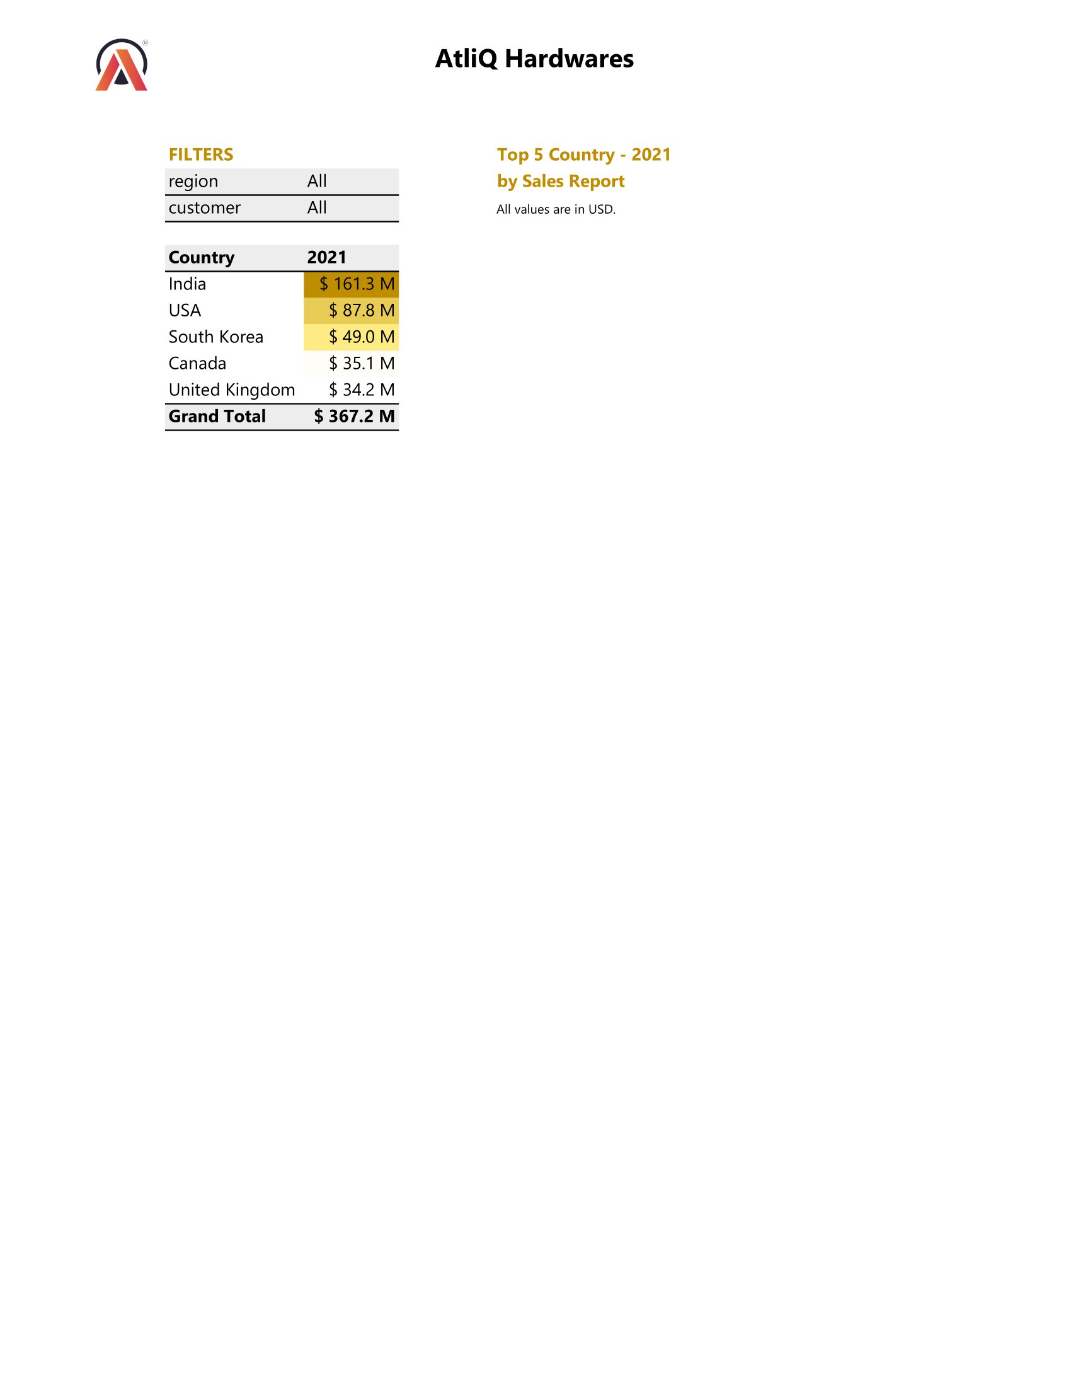
Sales: Division, Country, New Products Reports
7.4
12

Slide 13
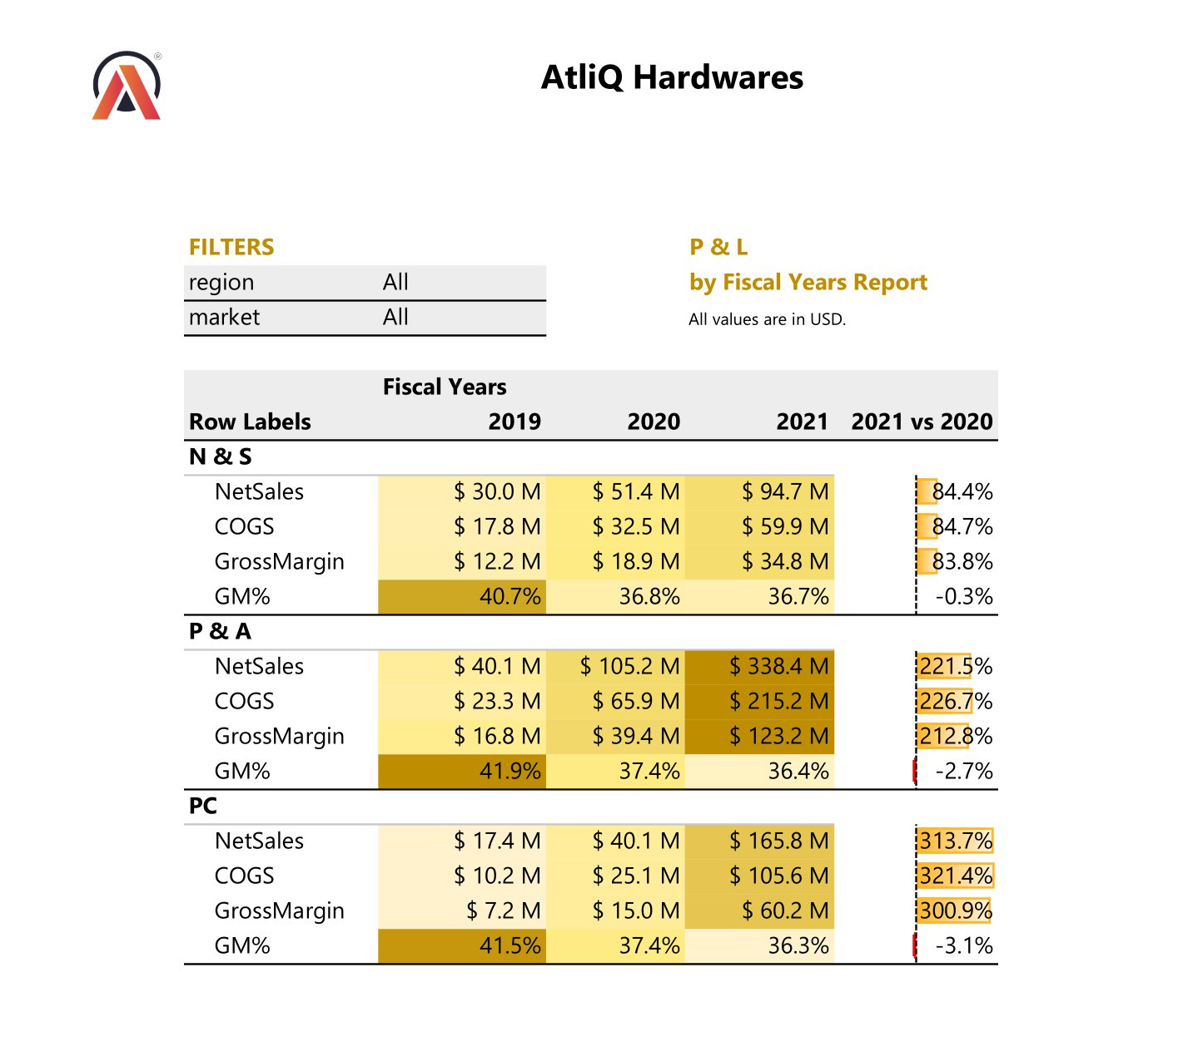
Finance: P & L by Fiscal Years Report
8.1
13

Slide 14
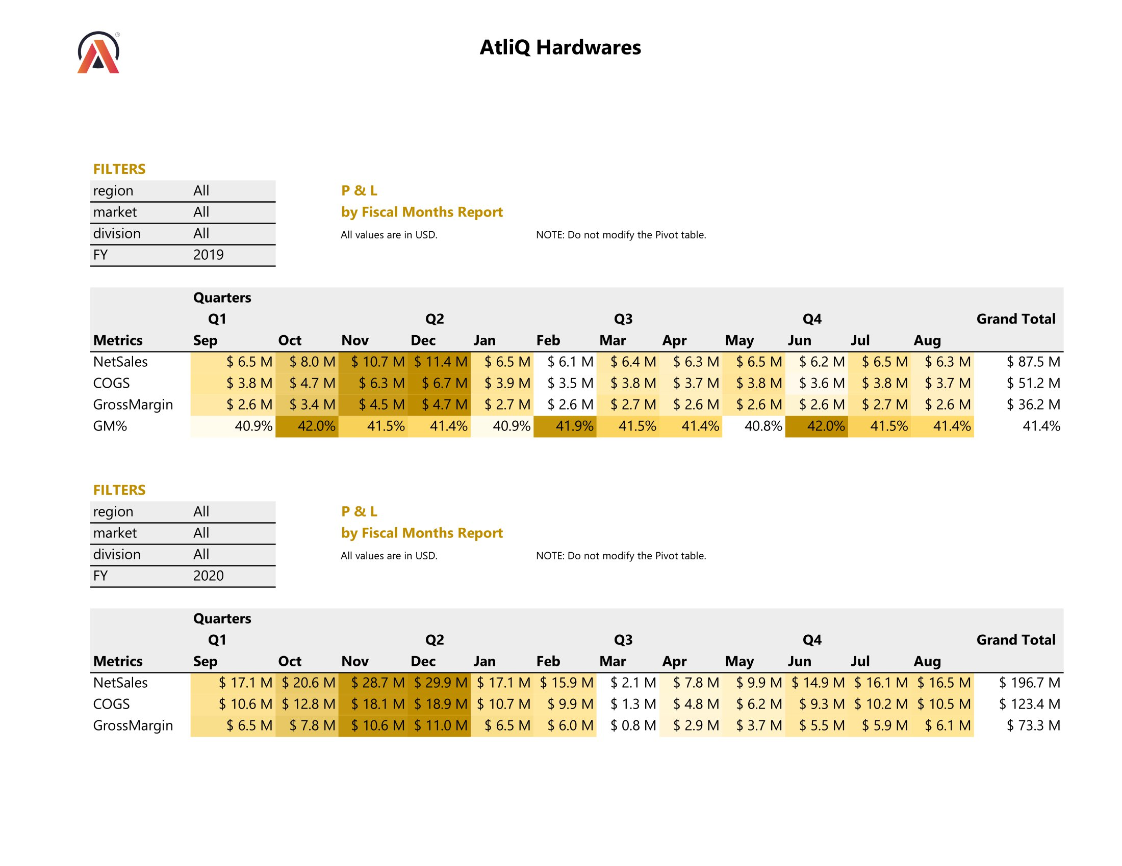
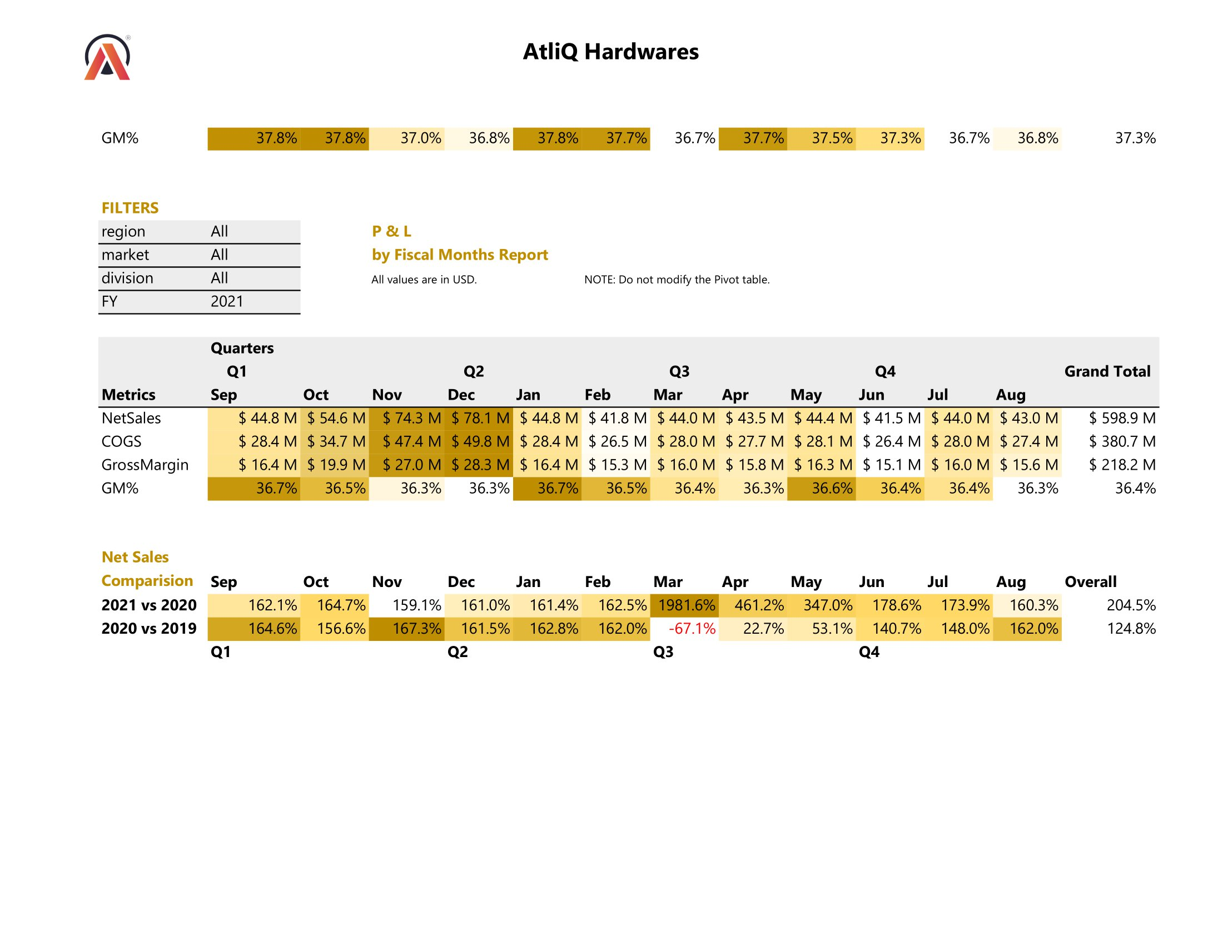
Finance: P & L by Fiscal Months Report
8.2
14

Slide 15
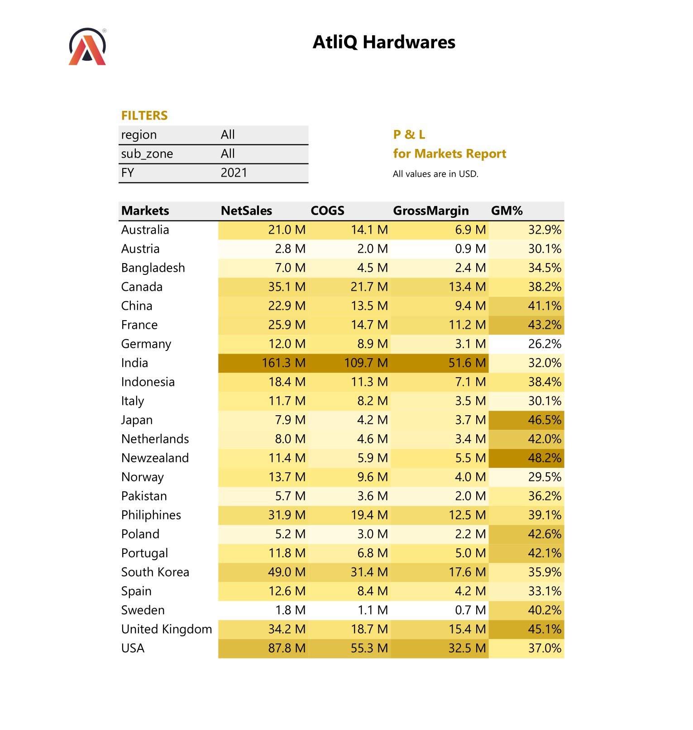
Finance: P & L by Markets Report
8.3
15

Slide 16
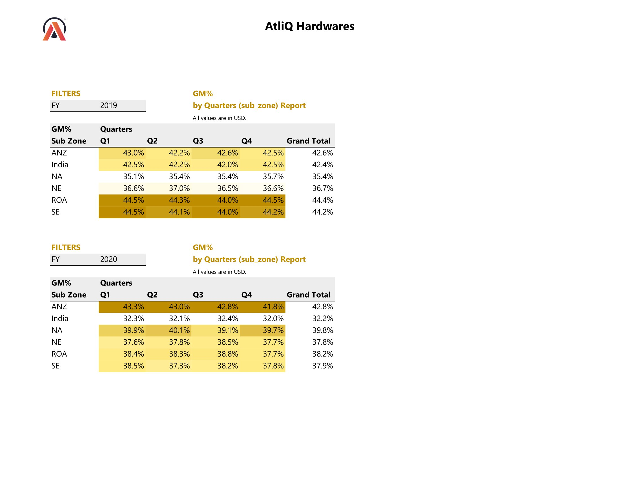
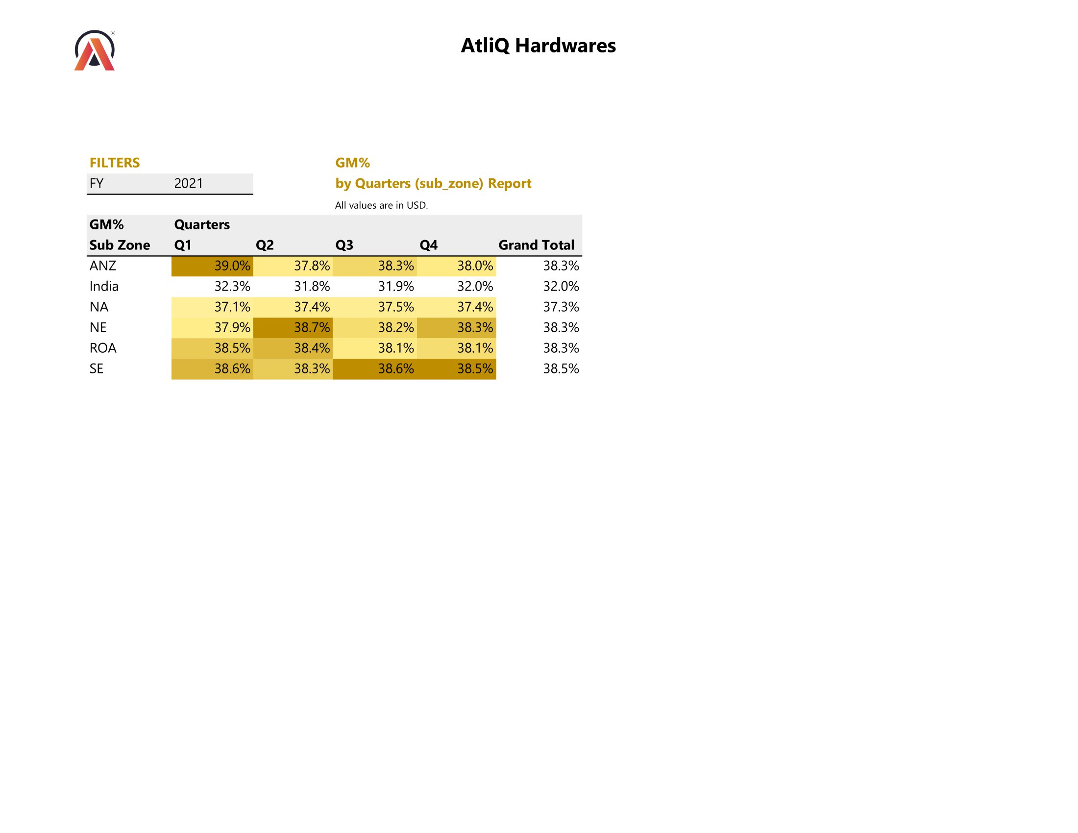
Finance: GM% by Quarters Report
8.4
16

Slide 17

Insights
Customer Amazon tops the charts by grossing Net Sales of $ 82.1 Million in 2021, while experiencing the lowest sales increment rate of 120%.
Customer Nova comes out with the Lowest Net Sales of $ 0.4 Million in 2021, while it experienced a sudden high surge in Sales with the Net Sales figure increasing almost 26.6 times from 2020 to 2021.
India dominates as the forerunner with Net Sales at a staggering $ 161.3 Million in 2021, while missing to meet its 2021 Net Sales Targets by $ 9.6 Million (5.6%).
Across the globe, Poland fails to meet its 2021 Net Sales Targets by the widest margin of around -15%.
Top 3 customers: Amazon, AtliQ Exclusive, AtliQ e-store in 2021 with individual Net Sales over $ 50 Million.
Top Selling Product: AQ Master wired x1 Ms with over 4.2 Million units sold from 2019 to 2021.
Top Surging Product: AQ Mx NB surges in demand almost 57 times from 2020 to 2021.
Top New Product: AQ Qwerty leading sales at $ 22 Million among the 16 new products introduced in 2021.
Gross Margin % takes the biggest hit of -3.1% in 2021 compared to 2020 for the PC region.
Sales peak consistently during Festive season months from October to December across the globe following the trend across years.
17

Slide 18

Thank you!
Thanks for checking out this project. I truly appreciate it.
Reach out for discussion/suggestions:
sagarmore.work@gmail.com
Connect with me on LinkedIn!
18

